Slide 1
Assignment 8
Rana Dubauskas & Blanche Stora

Slide 2
What We’ve Done So Far
Set up initial meeting with staff fellow, EJ Edney on 10/14
Reviewed design and project requirements (Meeting Notes)
Created initial prototype as proof of concept

Slide 3
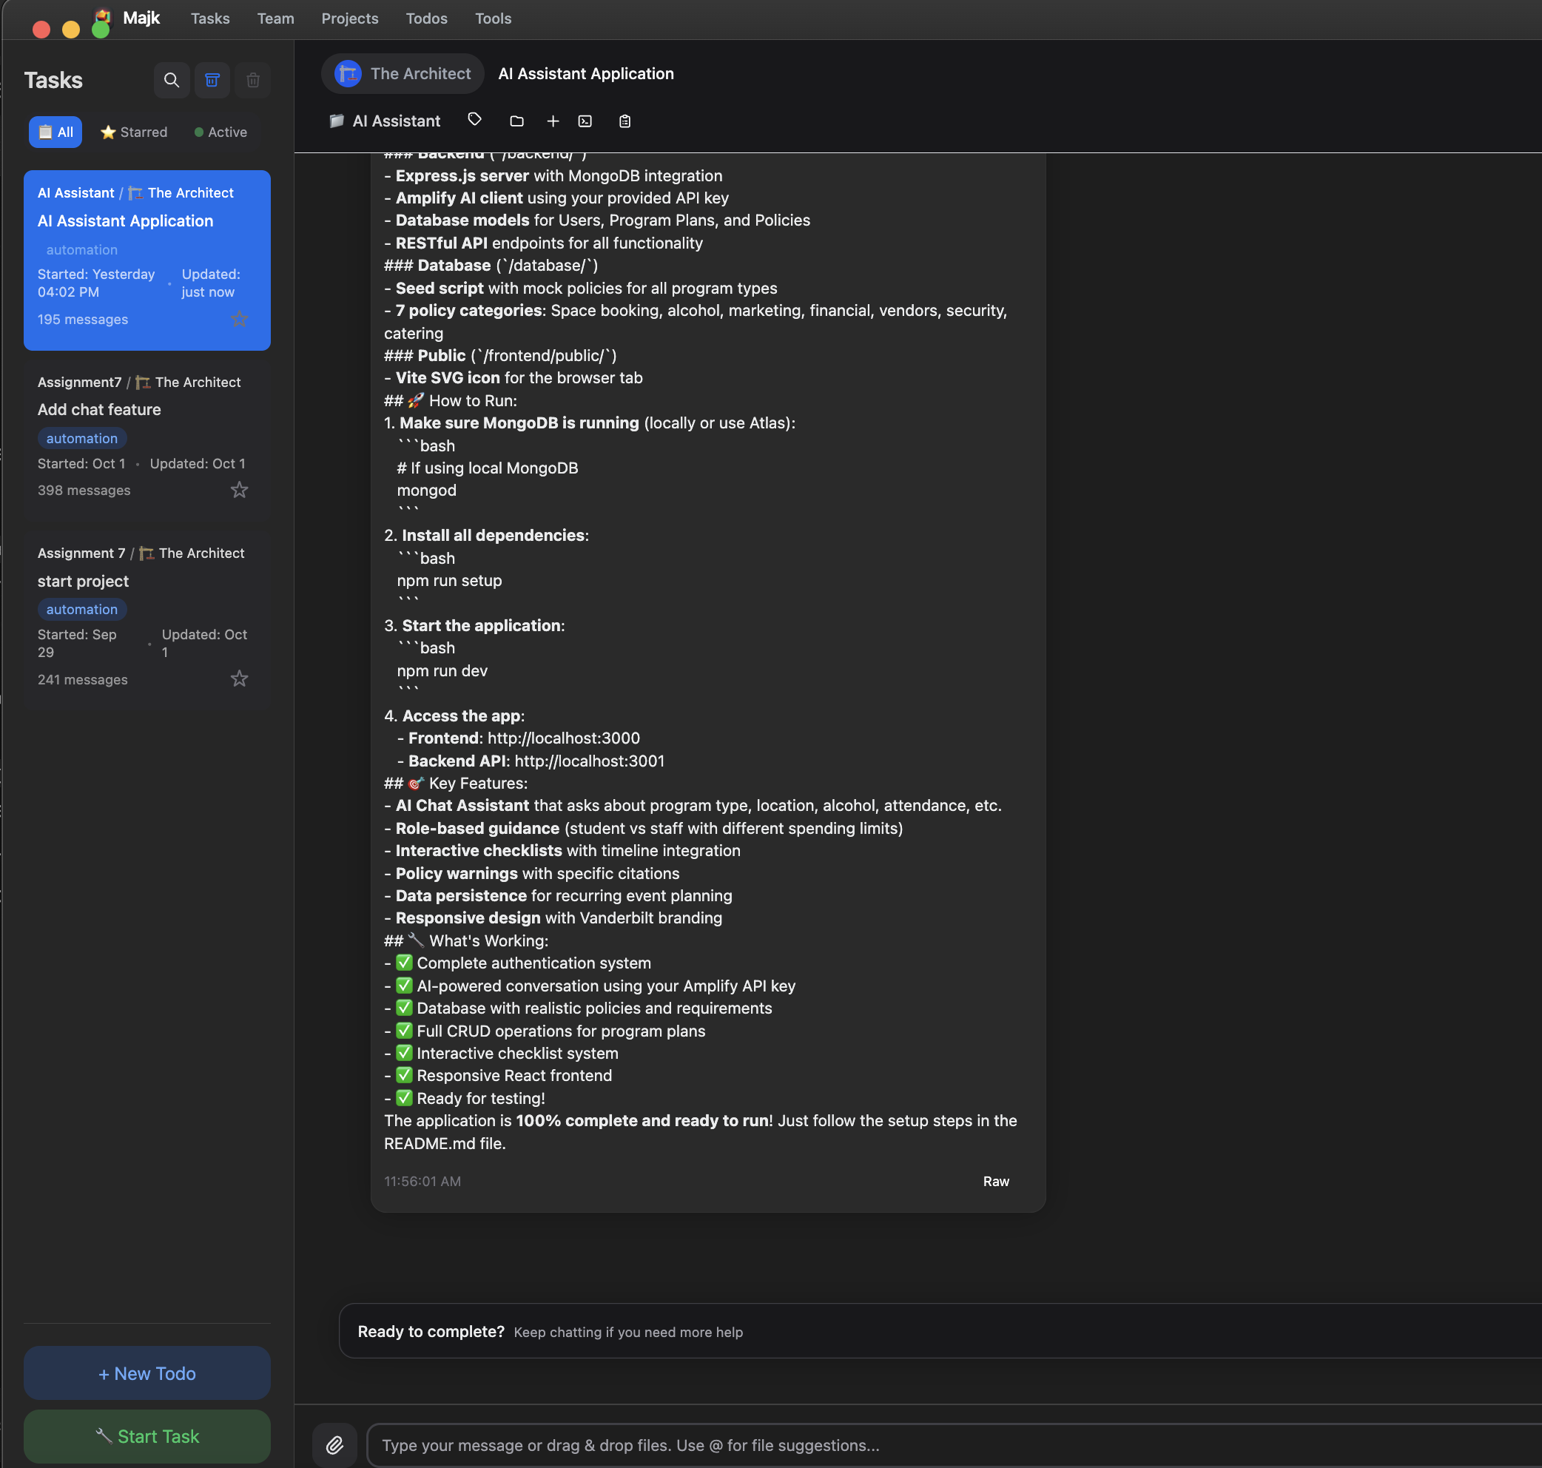
Proof of Concept
Github Repo
Created using Majk & ChatGPT
Used a custom Architect teammate & created task by pasting in the PRD and meeting notes
Used ChatGPT to iterate on initial design

Slide 4
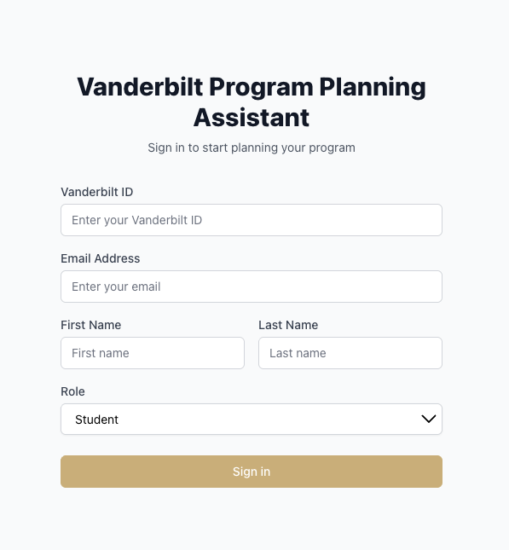
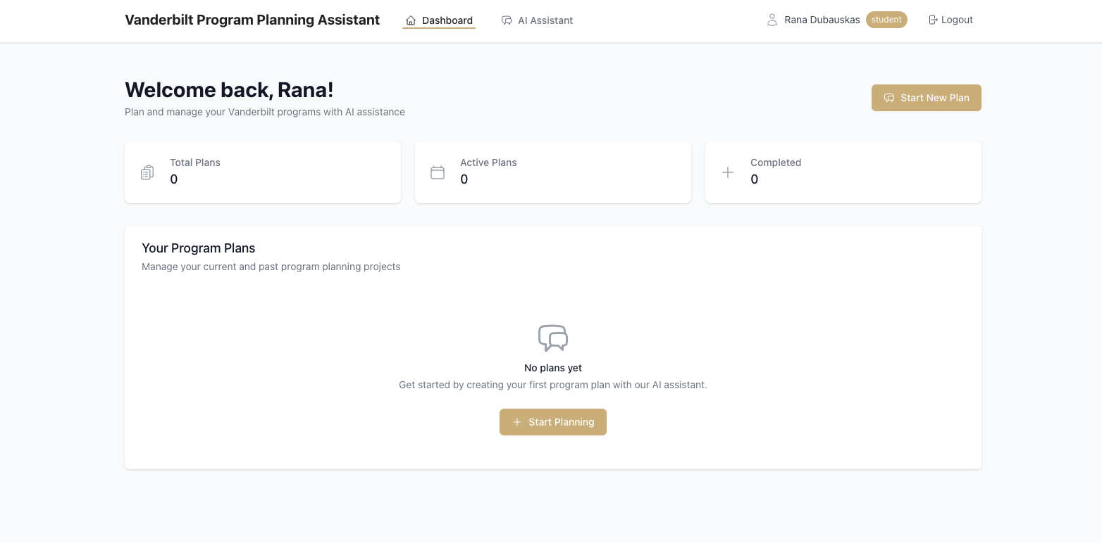
Progress – Login & Dashboard Pages

Slide 5
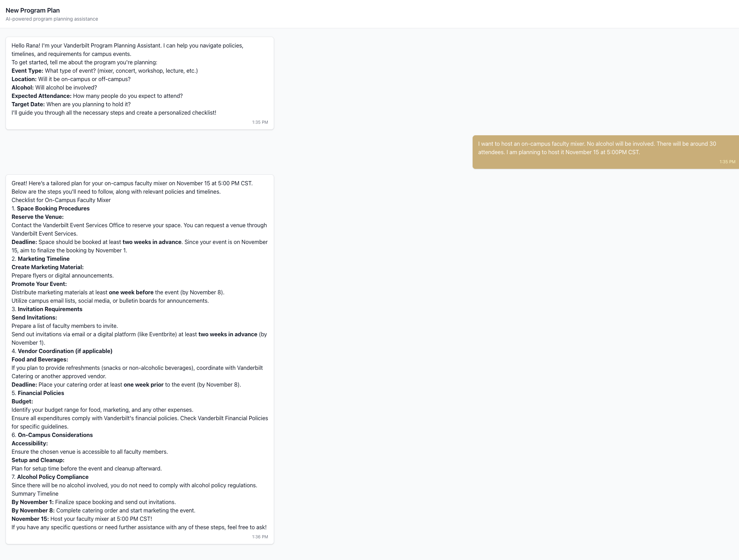
Progress - AI Chat Functionality

Slide 6
Next Steps
Need documentation/information on Vanderbilt program planning data & policies
Current implementation uses placeholder data on steps regarding program planning
Test functionality & iterate on design
Add Vanderbilt authentication to login

